Slide 1
LOCOMEDIA
Anthony Alvin 535200061
Mathew judianto 535200047
Zendi ibrahim 535200084
Melvin pramudita 535200060
Raihan Tara 535200046

Slide 2



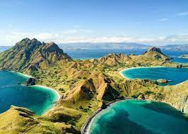
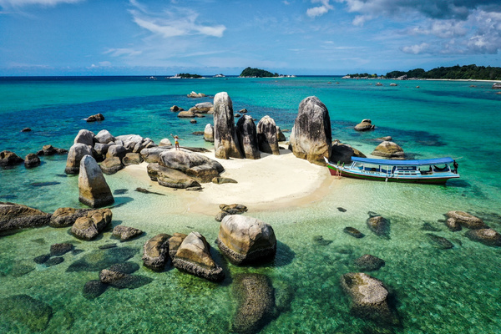
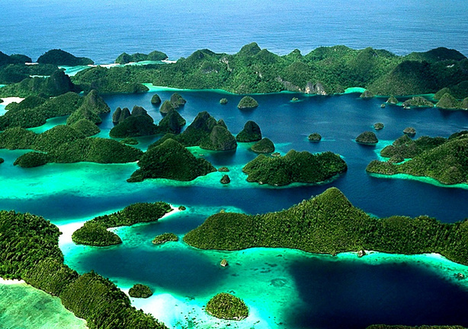
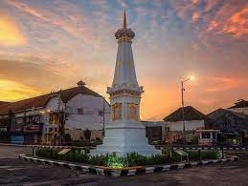
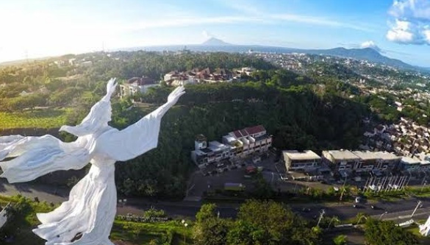
HOMEPAGE
LOCOMEDIA
BALI
NTT
BELITUNG
Bali is a province of Indonesia and the westernmost of the Lesser Sunda Islands
East Nusa Tenggara is the southernmost province of Indonesia. It comprises the eastern portion of the Lesser Sunda Islands
Belitung (or in English, Billiton) is an island on the east coast of Sumatra, Indonesia in the Java Sea.
PAPUA
JOGJAKARTA
SULAWESI UTARA
Papua, formerly Irian Jaya, is the largest and easternmost province of Indonesia
Dhaérah Istiméwa Yogyakarta) is a provincial-level autonomous region of Indonesia in the southern Java.
North Sulawesi (Indonesian: Sulawesi Utara) is a province of Indonesia. It is located on the Minahasa Peninsula of Sulawesi,

Slide 3
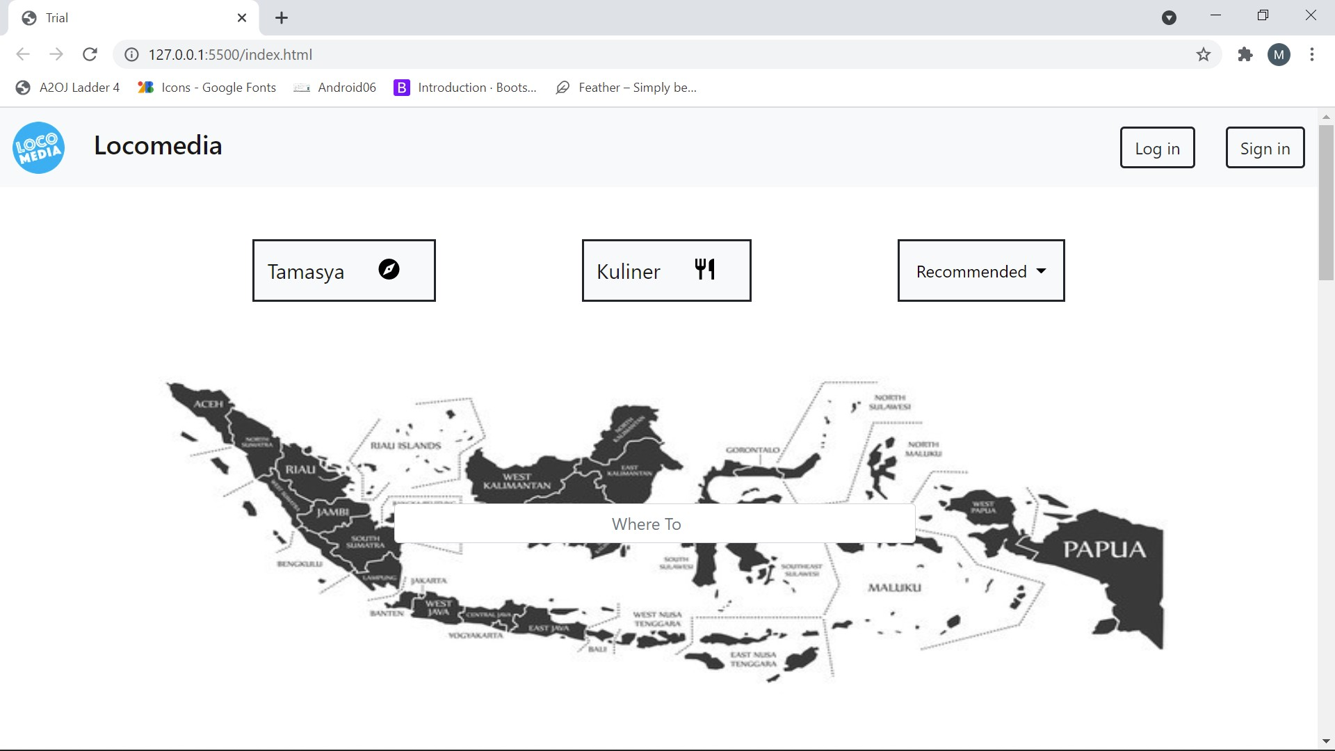
Homepage

Slide 4
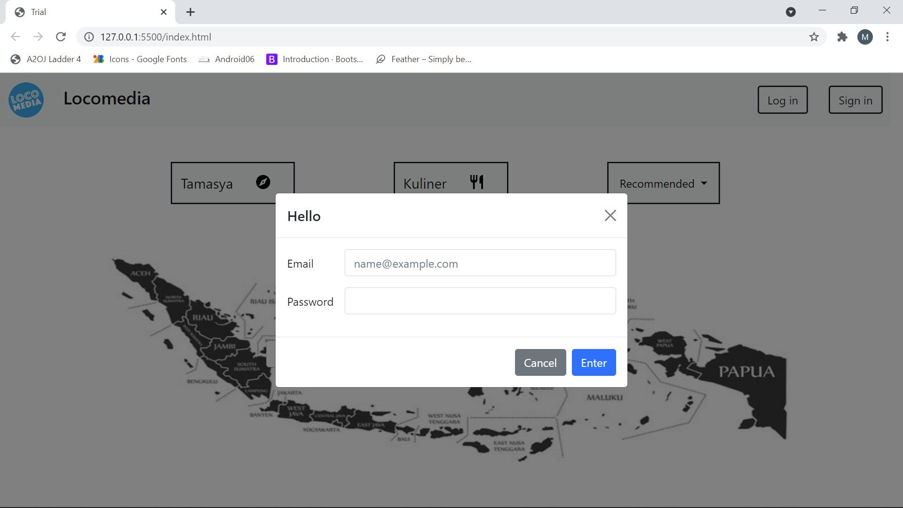
Login signin

Slide 5
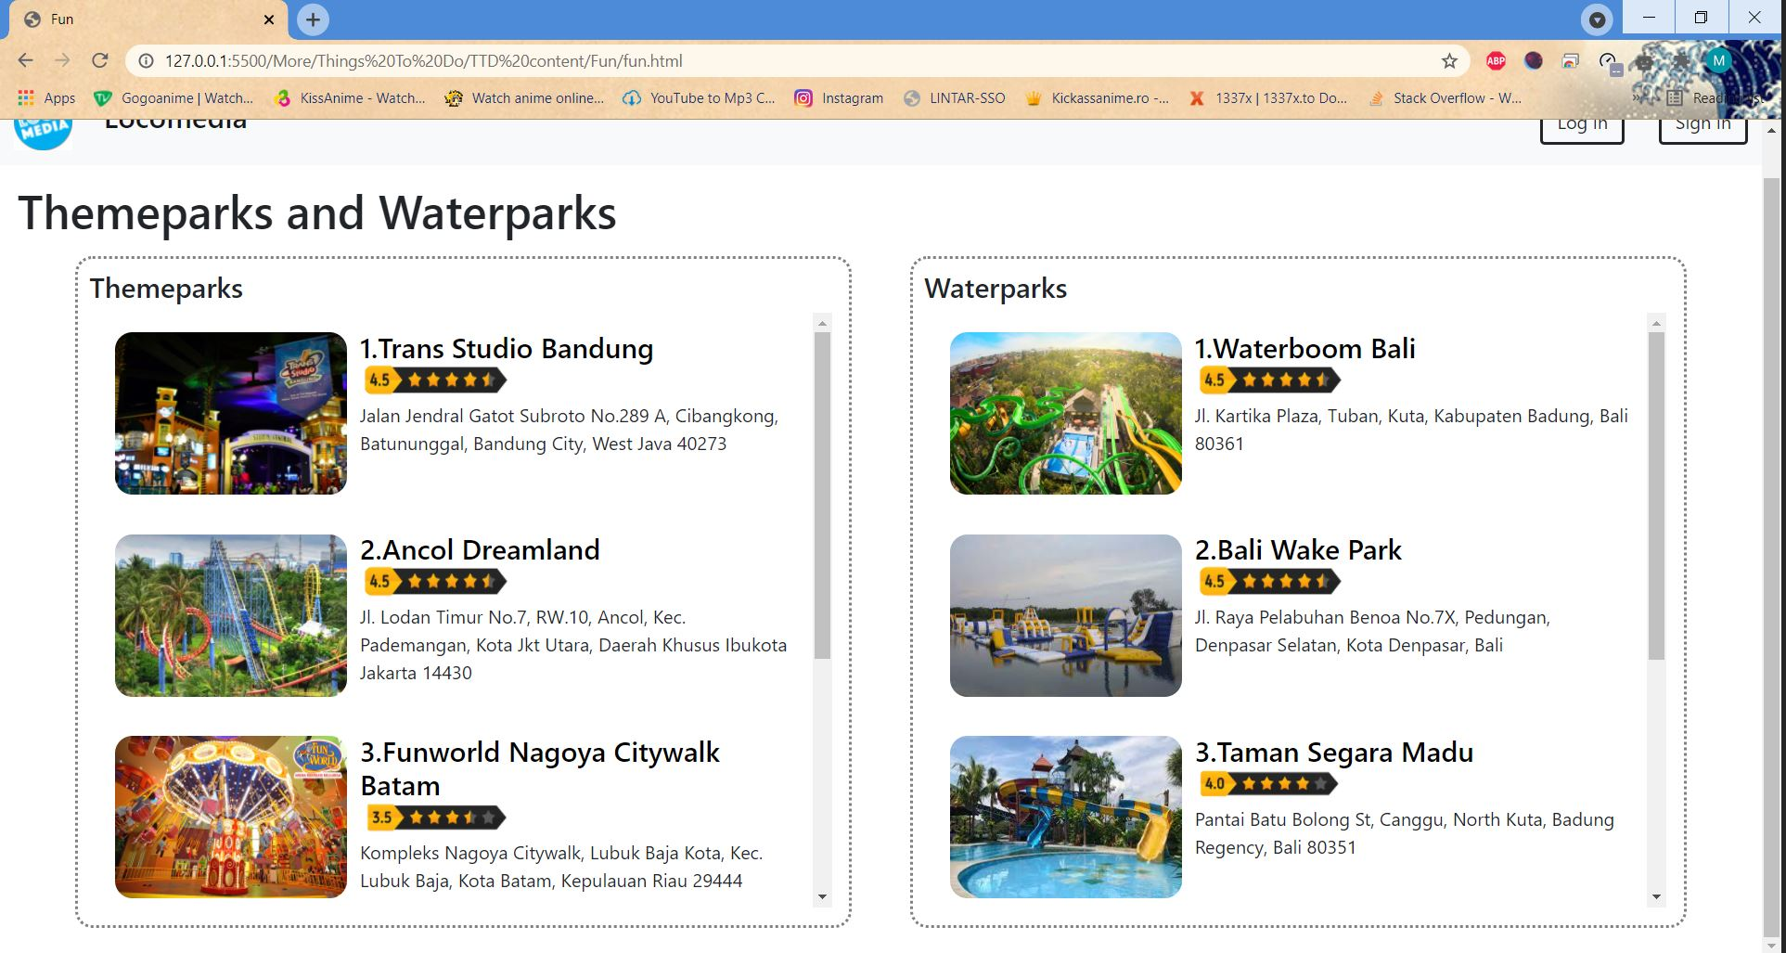
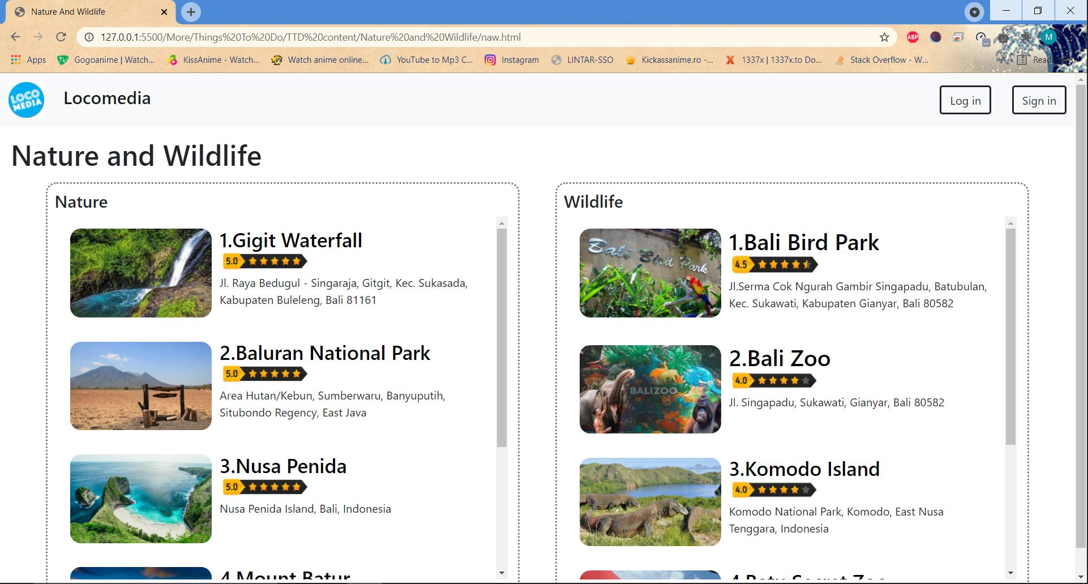
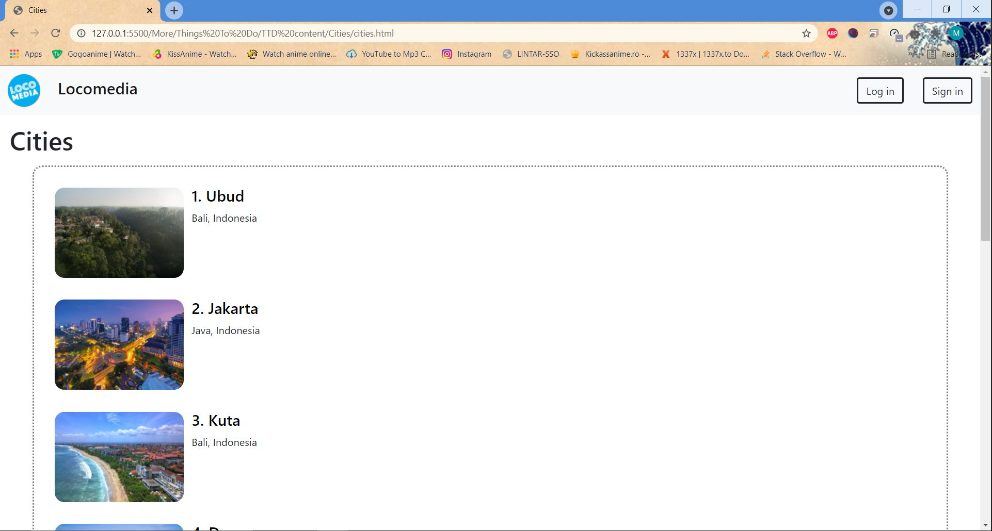
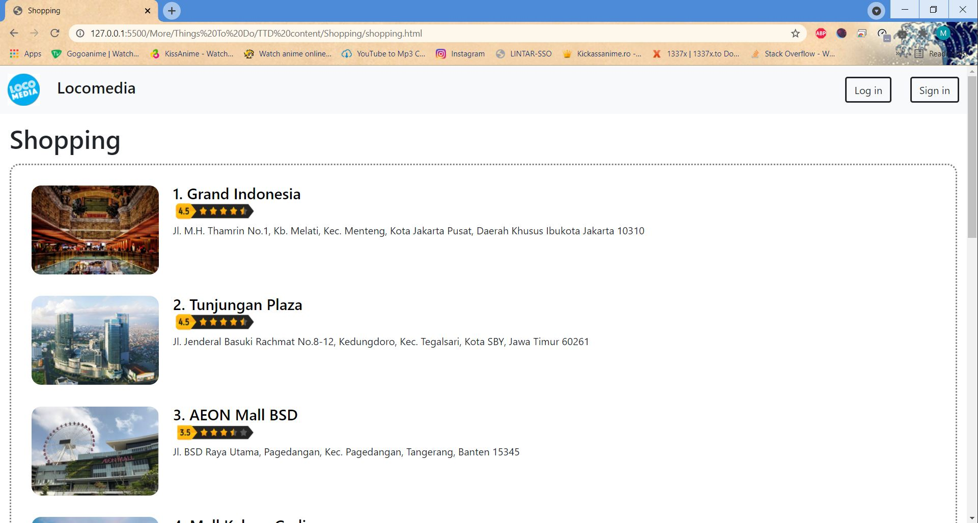
Recommended
Fun
Cities
Nature
Shopping

Slide 6
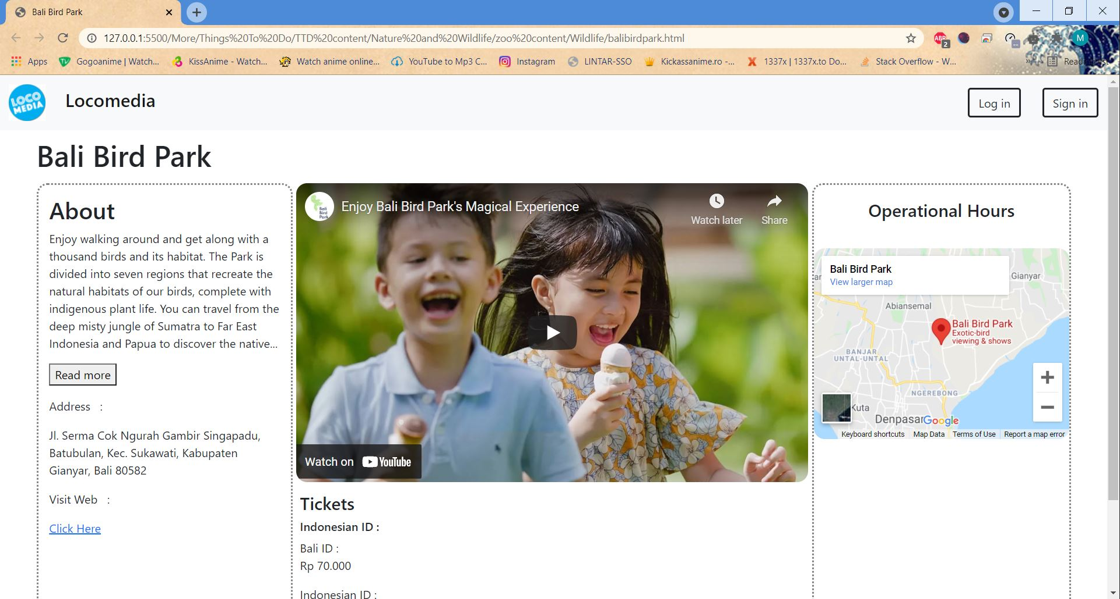
Contoh isi recommended

Slide 7
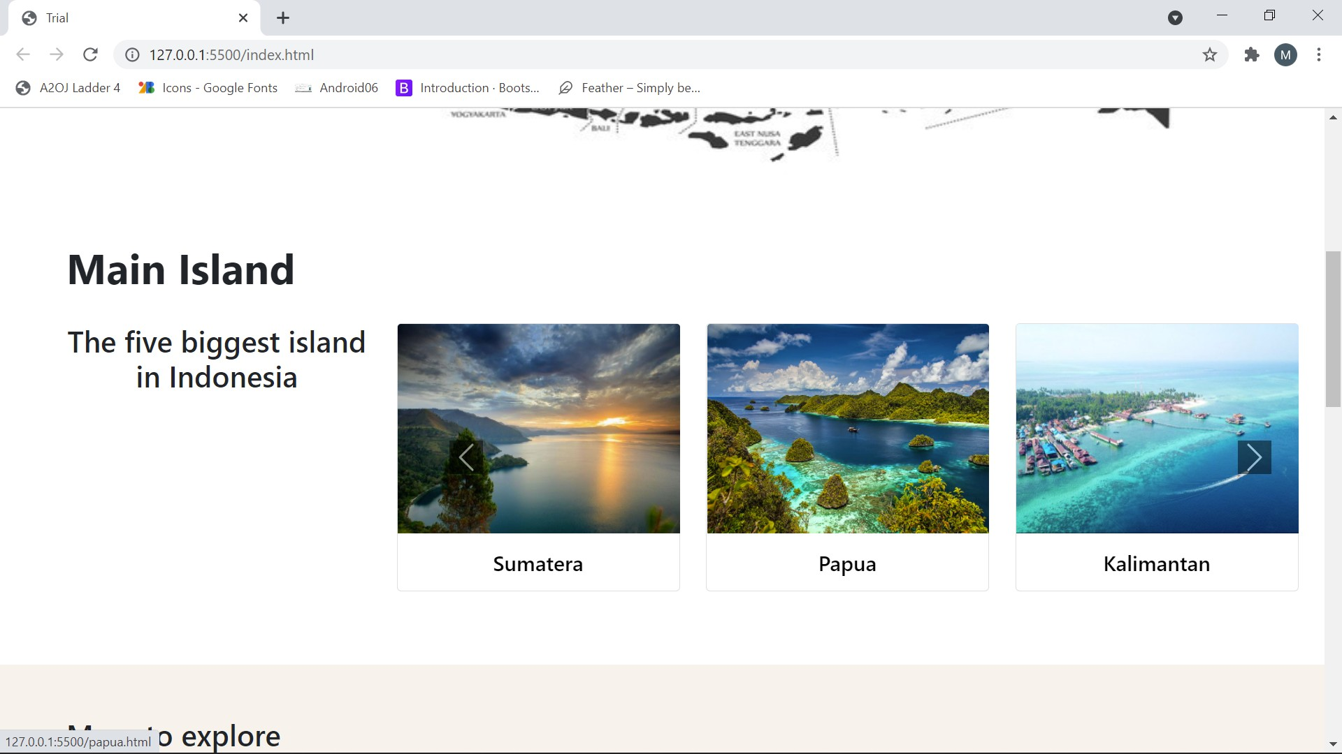
Main island

Slide 8
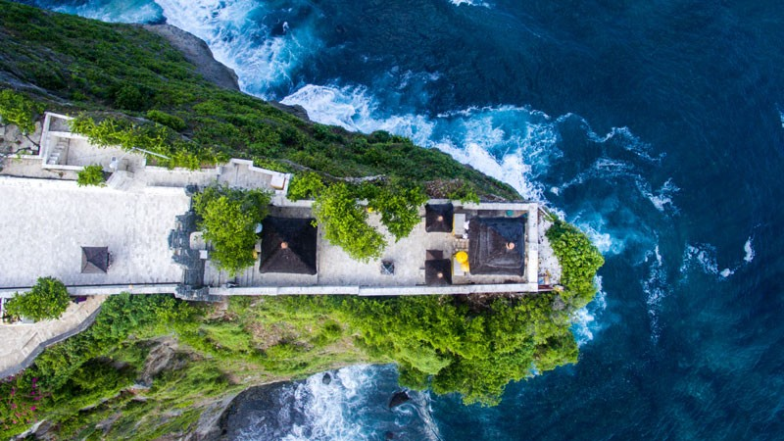
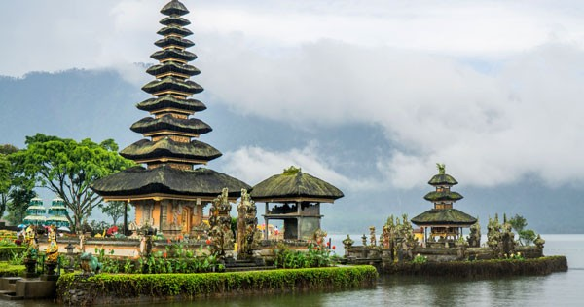
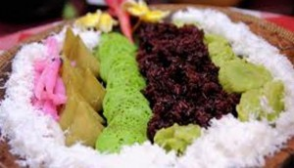
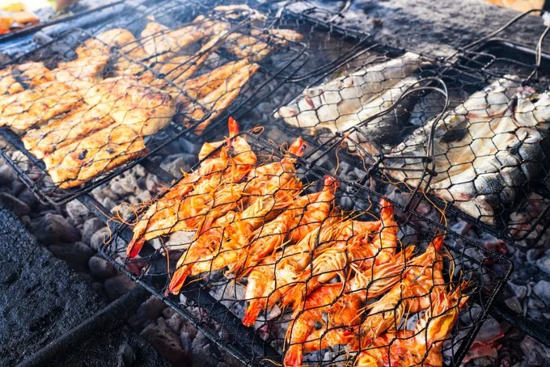

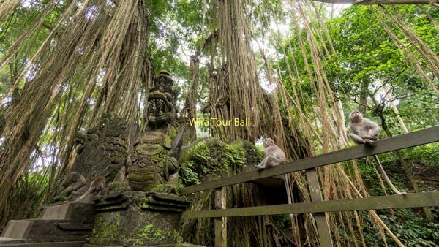

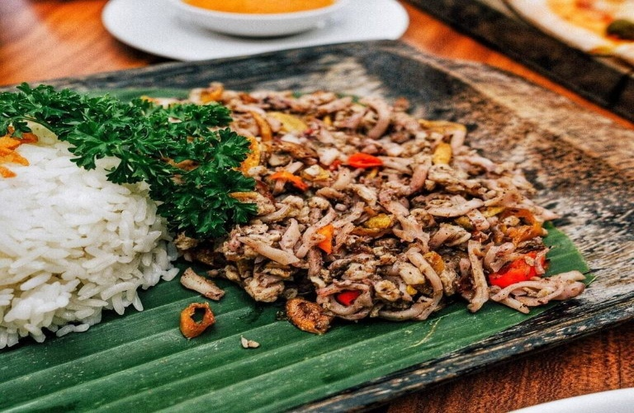
BALI
LOCOMEDIA
DESTINASI
KULINER
PURA ULUWATU
PURA ULUN DANU
AYAM BETUTU
SEAFOOD JIMBARAN
AIR TERJUN SEKUMPUL
UBUD MONKEY FOREST
JAJA BALI
LAWAR CUMIT

Slide 9
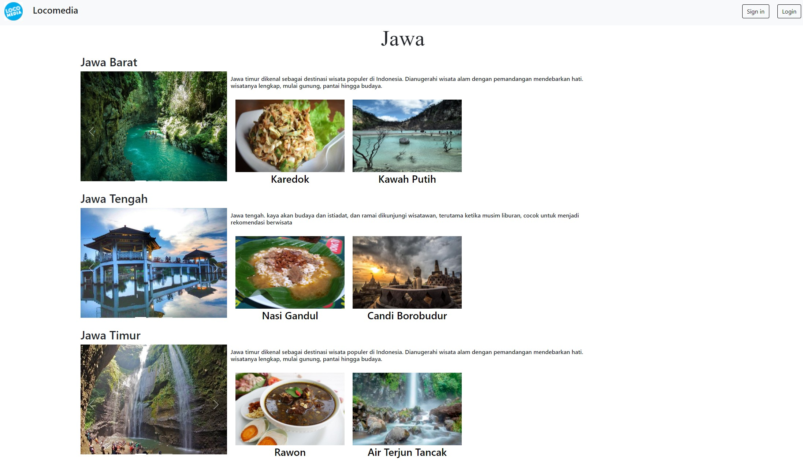
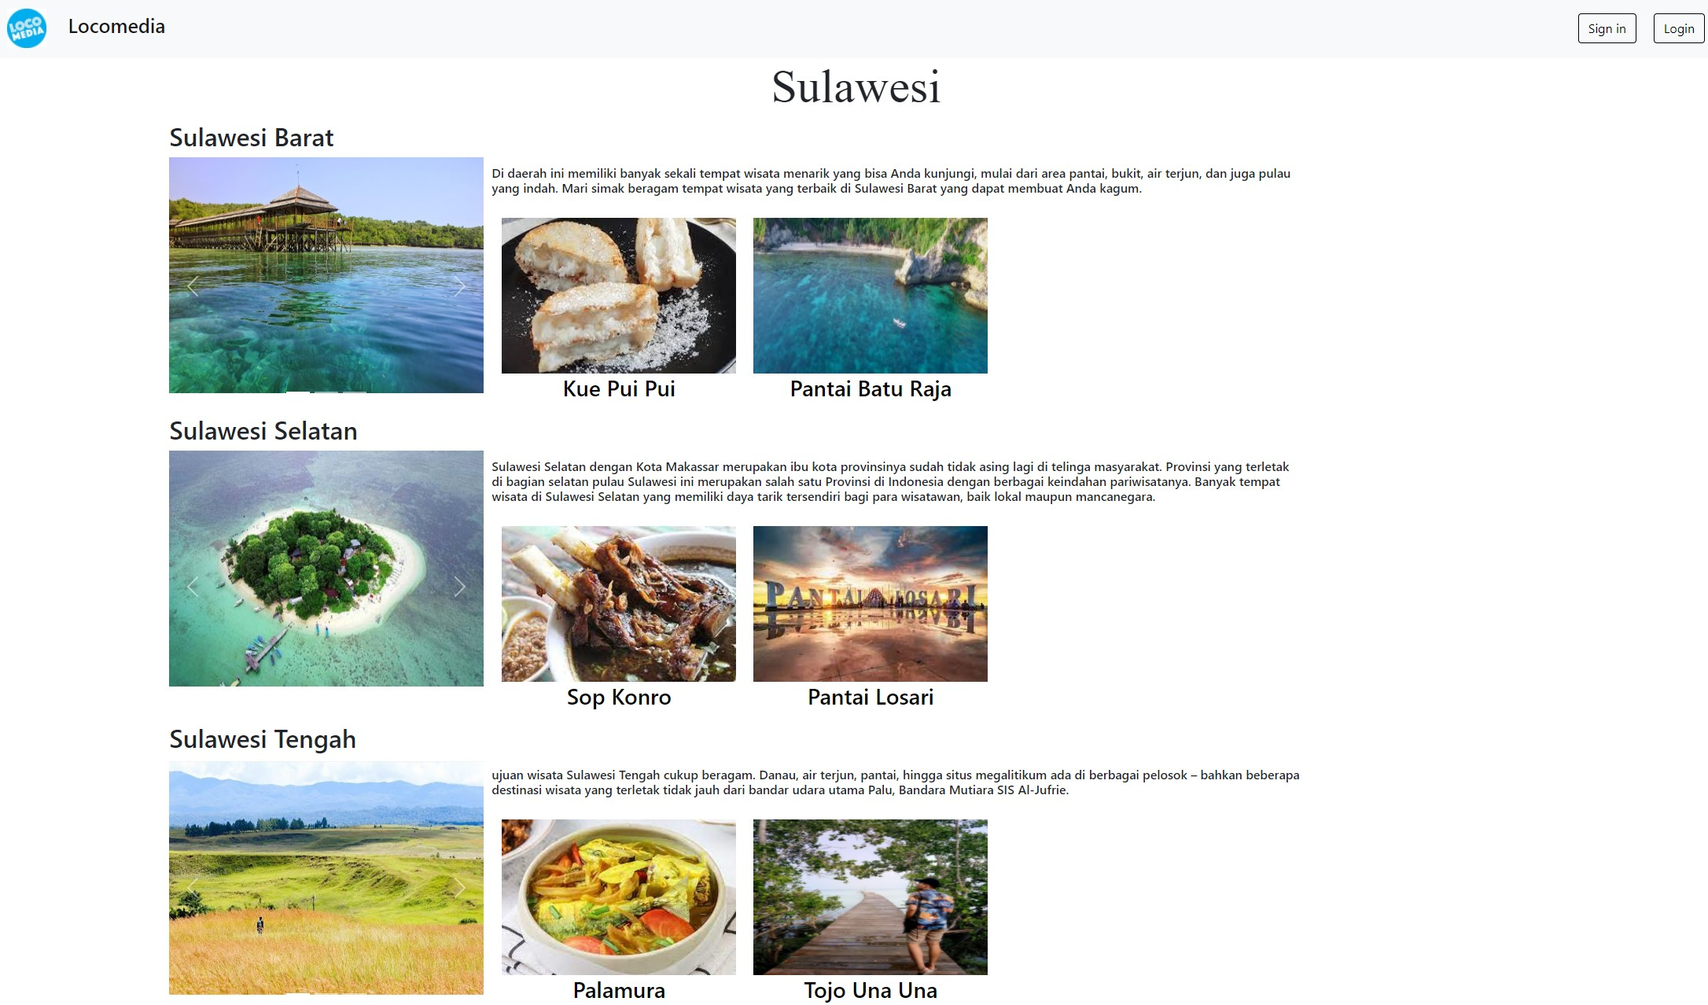
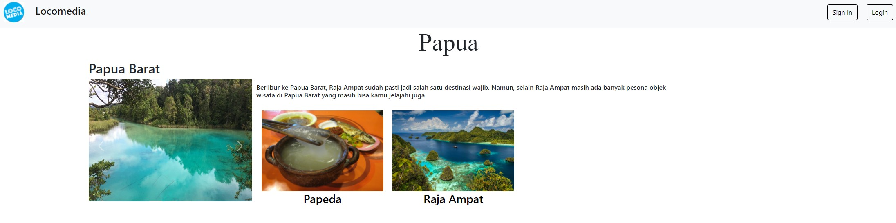
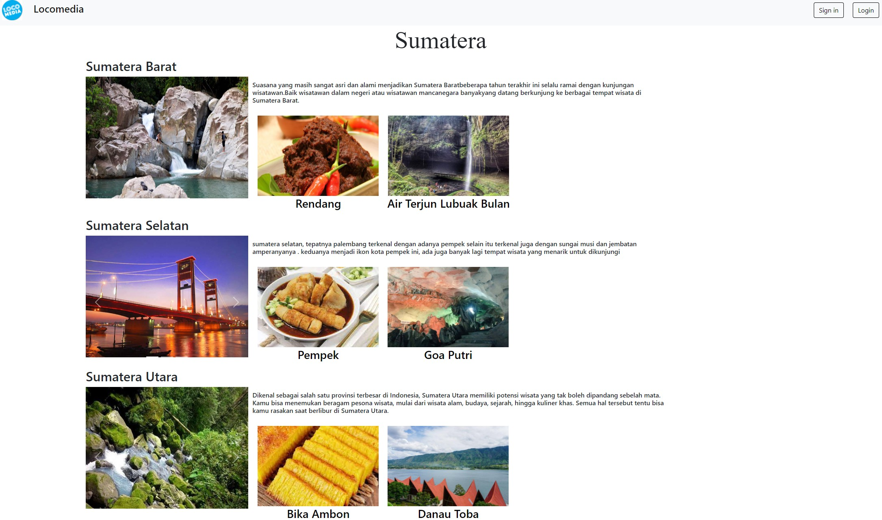
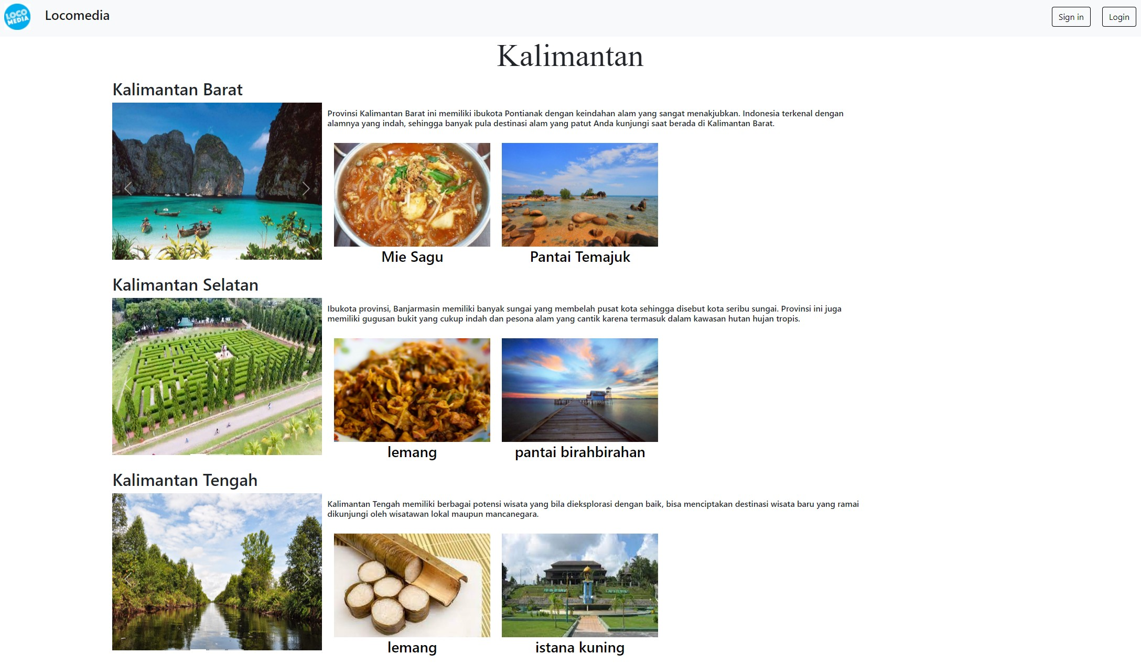
Main Island

Slide 10

Artikel

Slide 11
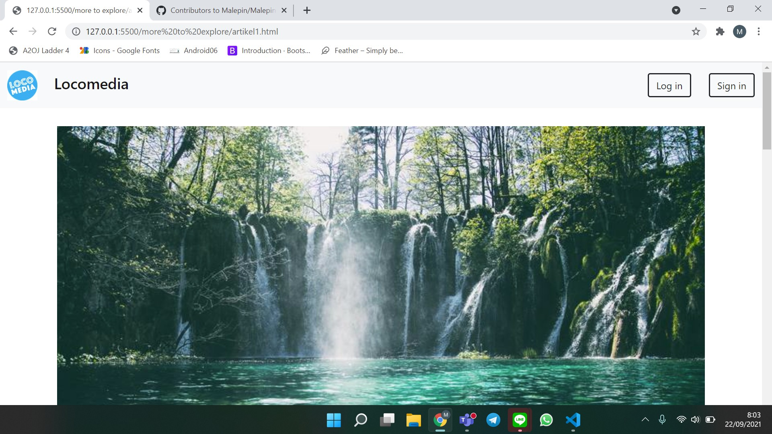
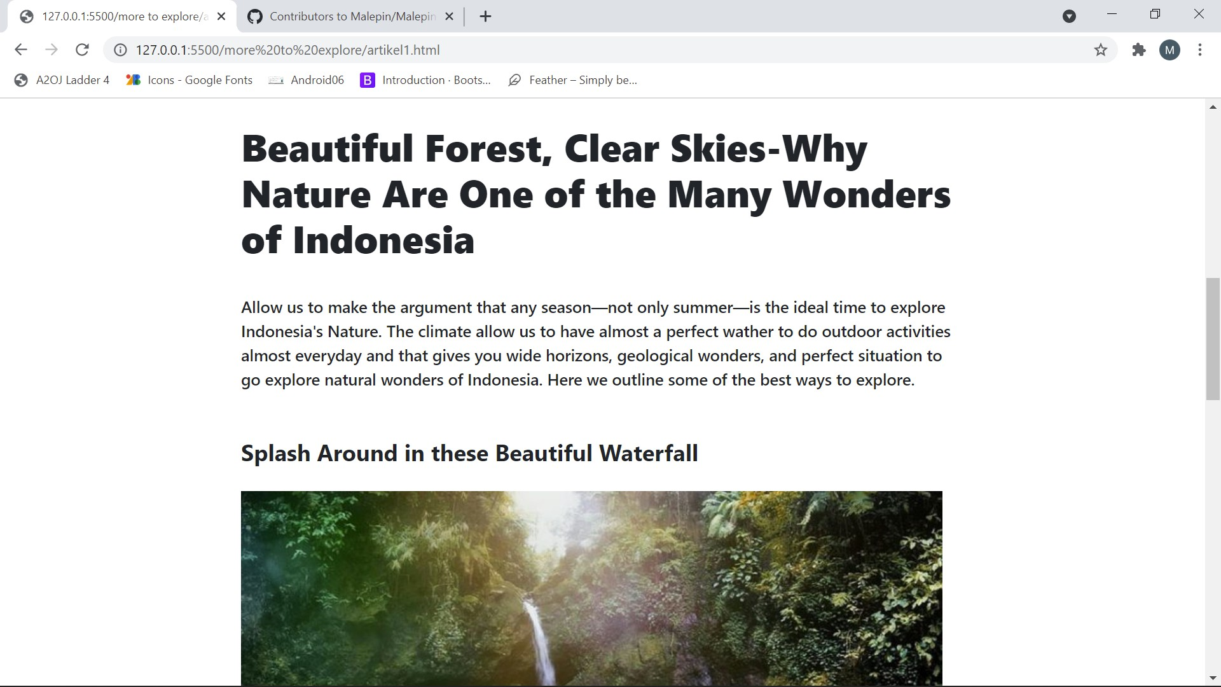
Header & title artikel

Slide 12
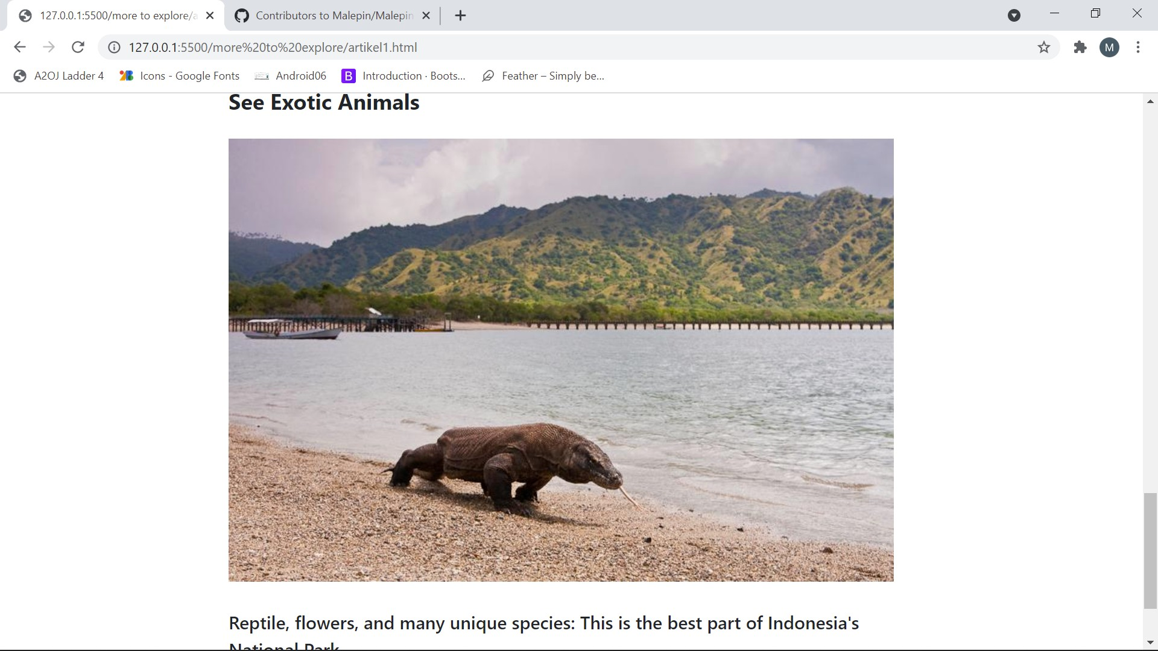
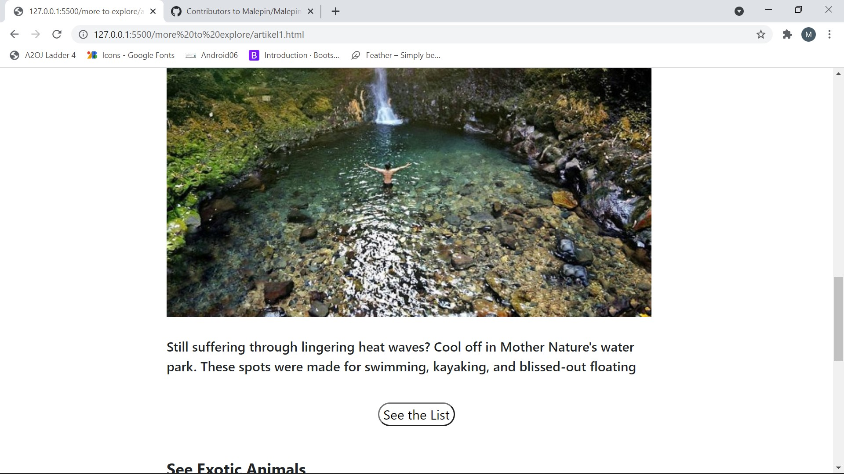
Isi artikel

Slide 13
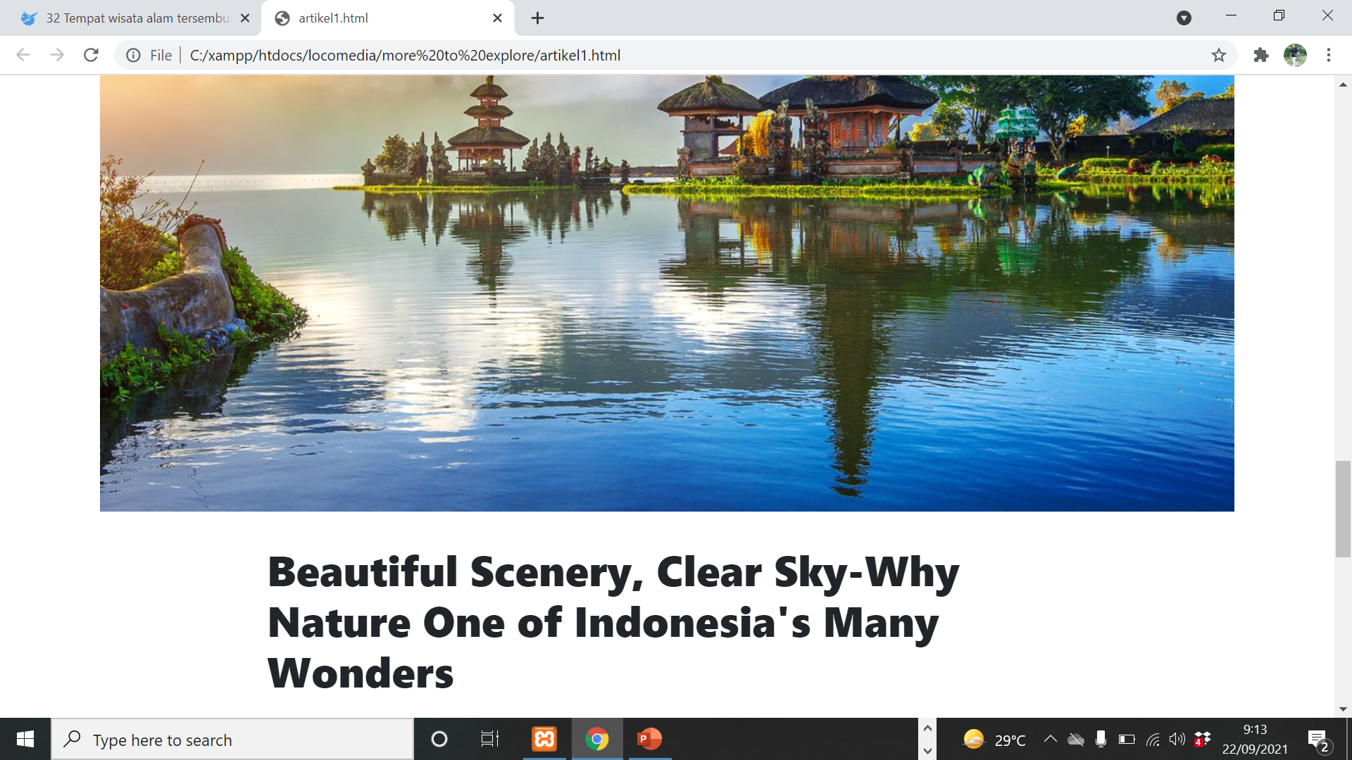
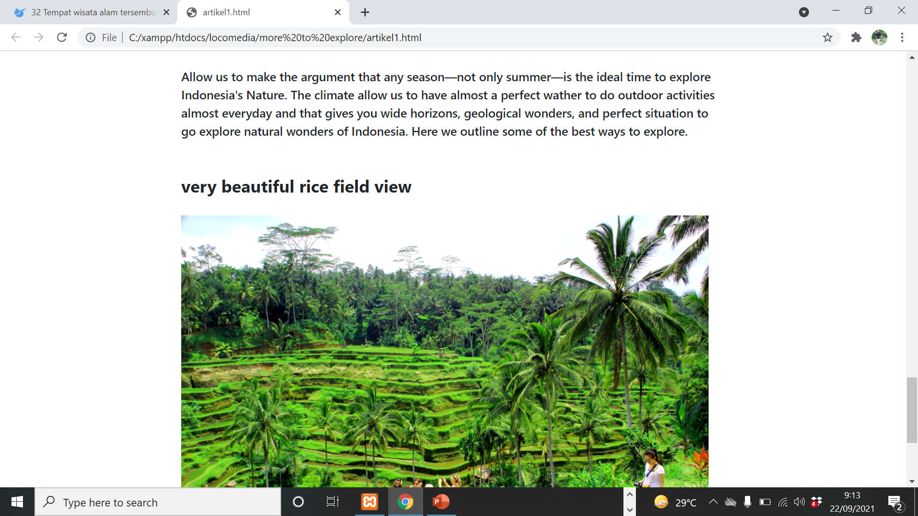
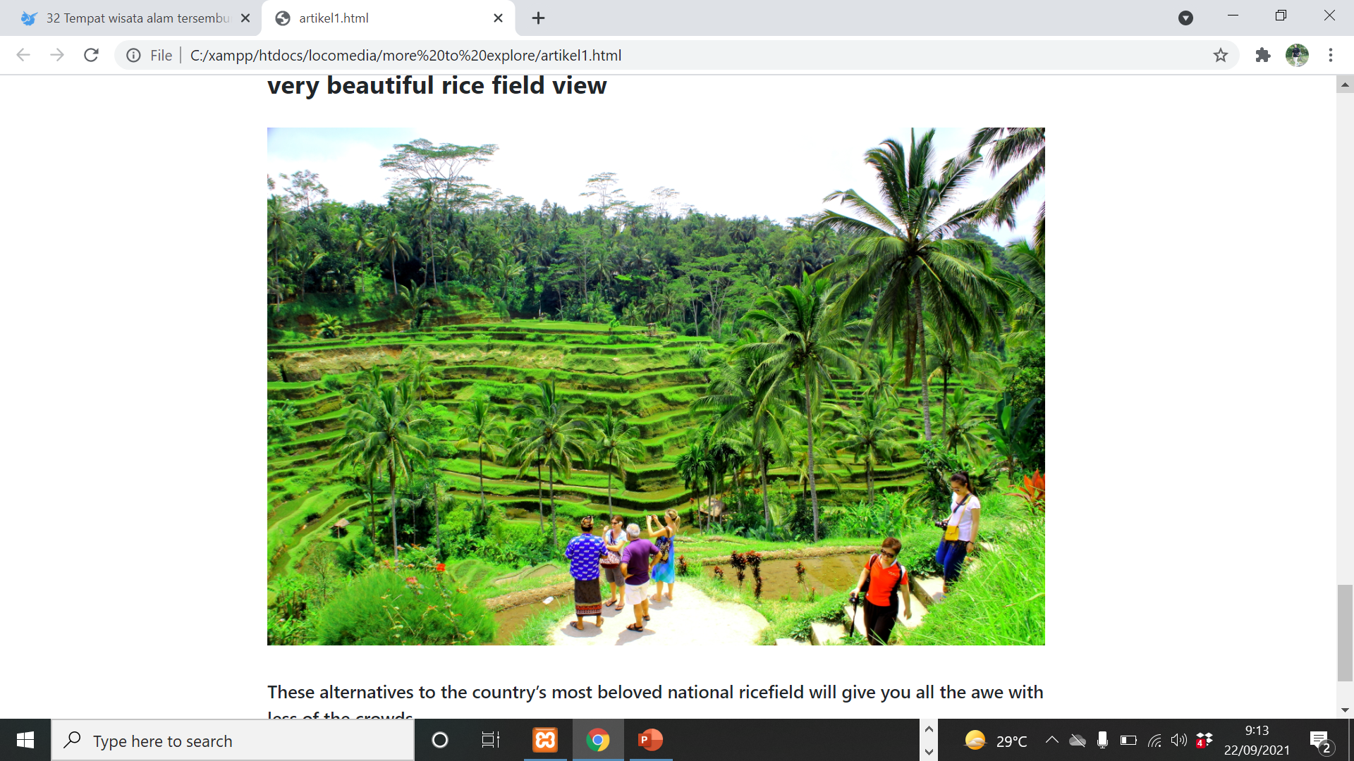
Isi artikel

Slide 14
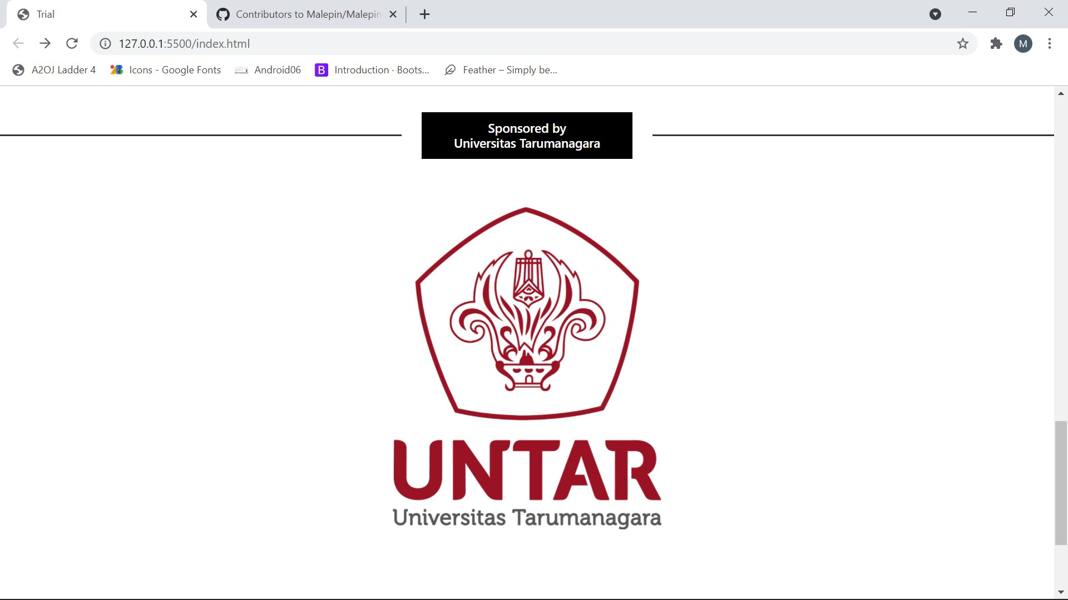
sponsor

Slide 15
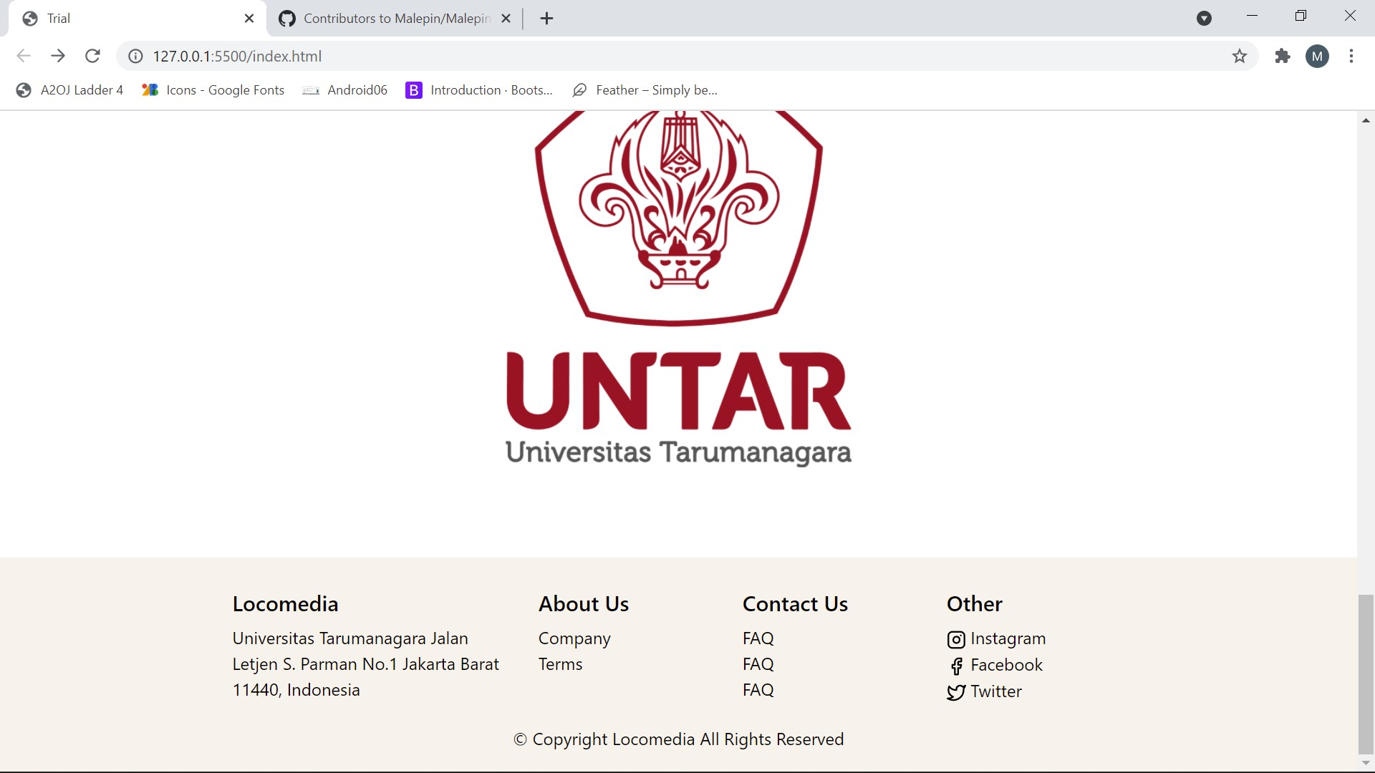
footer

